Slide 1
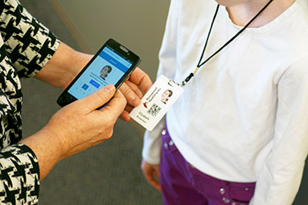
QR CODE
SUBMITTED BY:
Deepika. A (15JN1A0510)
Mahima. K (15JN1A0522)
Nandhini. B (15JN1A0559)
Swathi. A (15JN1A0523)
UNDER THE GUIDANCE OF
DURGA DEVI. K
ASST PROFESSOR

Slide 2
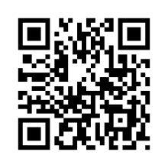
REGISTRATION FORM
STUDENT NAME
STUDENT COLLLEGE ID
GENDER
DATE OF BIRTH
COURSE
BRANCH

Slide 3
REGISTRATION FORM
SECTION
BATCH NO
BLOOD GROUP
EMAIL ID
AADHAR ID

Slide 4
REGISTRATION FORM
PASSWORD
CONFIRM PASSWORD
SUBMIT
CANCEL

Slide 5
LOGIN FORM
COLLEGE ID
MOBILE NUMBER
PASSWORD
LOGIN
FORGET PASSWORD

Slide 6
DATABASE SCHEMA
FIELDS | DATATYPE | CONSTRAINTS | DESCRIPTION
Name | Varchar(50) | Not null | name
Roll no | Bigint(10) | Primary key | College id
Branch | Varchar(50) | Not null | Branch
Year | Numeric(4) | Not null | Year
Mobile no | Numeric(10) | Not null | Mobile no
Blood Group | Enum(2) | Not null | Blood Group
Date of birth | Numeric(10) | Not null | Date of birth
Course | Varchar(10) | Not null | Course
Section | Varchar(1) | Not null | Section

Slide 7
LOGIN TABLE
FIELDS | DATATYPE | CONSTRAINTS | DESCRIPTION
Roll no | Bigint(10) | Primary key | College id
Password | Varchar(8) | Not null | Password

Slide 8
STUDENT INFORMATION
FIELDS | DATATYPE | CONSTRAINTS | DESCRIPTION
Name | Varchar(50) | Not null | name
Roll no | Bigint(10) | Primary key | College id
Branch | Varchar(50) | Not null | Branch
Year | Numeric(4) | Not null | Year
Mobile no | Numeric(10) | Not null | Mobile no
Blood Group | Enum(2) | Not null | Blood Group
Date of birth | Numeric(10) | Not null | Date of birth
Course | Var char(10) | Not null | Course
Section | Var char(1) | Not null | Section

Slide 9


